Slide 1
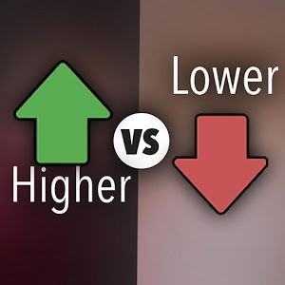
Higher or Lower
Jessica Yip & Dennis Lin

Slide 2
Project Overview
A number from 1-10 is displayed on the screen
Player guesses whether the next number will be higher or lower than the current number.
If the guess is correct, a new number is generated and the game continues.
If the guess is incorrect, the game ends.

Slide 3

Background/Motivation
Based off a game of chance
Simple game design
But new challenge of using a microcontroller

Slide 4
Design
Tiva LaunchPad
LCD Screen BoosterPack
Coding in C in CCS
Two RectangularButtons for player decision (High or Low)
Canvases for title and currentNum display

Slide 5
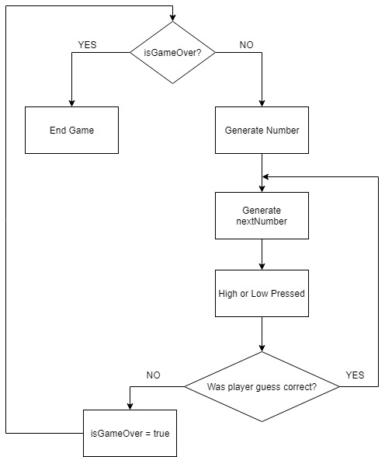
Design:
Flow Chart

Slide 6
Result
and
Challenges
LCD Screen was slightly defective
RectanglularButton, Canvas, CanvasStruct functions and parameters
Generating a random number on a microcontroller
Unable to use CPU clock

Slide 7
Conclusion/Future Plans
Implement a score tracker
Score earned could depend on probability of higher/lower outcome
Introduce a betting system
Player can choose to wager a certain amount of points
Use an image for the current card
Use a built-in sensor in the microcontroller to generate the random number

Slide 8
Thank you!

